Slide 1
LINKAGE OF INFORMATION SYSTEMS TO BUSINESS

Slide 2
There are many reasons why businesses want to develop information systems: These include:
  To reduce manpower cost: Introduction of systems enable people to work smart, it enables work to be done by fewer staff thereby reducing the cost of manpower.
  Eg: The automation of banking function such as clearing of cheques
  To improve customer service delivery: Computer systems often allow organizations to provide better customer service delivery, such as serving customers quickly, and or providing additional services to customers.
    E.g. Using the POS and the malls and the printout of itemized bills to customers

Slide 3
To improve Management Function: Decisions taken by management are as good as the information these decisions are based on. Computer systems and applications are designed to provide accurate and timely information to its users.
  Eg: Using an inventory system, management can generate reports to have a idea about the cash book of the organization, pattern of purchases, user preference, period of peak sales and low sales.
To remain and maintain Competitive:

Slide 4
Constraints of Information Systems
In proposing the design and implementation of a potential System by a System Analyst, the proposed solutions will be faced by a number of constraints imposed by the user as well as the nature of the business.
System Analyst need to understand these contraints before the analyses process begins
While designing a proposed solution these constraints must be factored into the design
Notes:
What are Constraints

Slide 5
Constraints of Information Systems
The User’s Organization Structure:
The analyst need to consider the structure of the organization.
Example: Does the organization have a centralized system where all decisions are taken by top management at the head office. The system should be designed as such. E.g. All approvals must be made a particular head.
In a nutshell, the designed system must reflect the decision making structure of the organization.
Notes:
In other words if the organization allows for autonomy for departmental managers, the system should be designed with features to allow such.

Slide 6
Working Practices
It is very easy to introduce a new system which mimics the existing work practices or culture of an organization.
However if management intends to change a culture or practice in an organization, introducing a new system might act as a catalyst for that change.
E.g. The introduction of a clocking –in system to check time in , and out, who came to the office when (office hours , out of office, access control etc)

Slide 7
Finance Control Procedures
An organization’s finance can have an impact on IT developments.
Security and Privacy
Analyst need to consider security and privacy conditions that will be required for the proposed system
Commercial Confidentiality: The aim is to ensure that sensitive information such as production cost, trade secrets, breakdown of production cannot be stolen by competitor
Sensitive Systems: Analyst need to ensure that adequate security consideration is applied to the access, modification and viewing of data
  Eg: Health Information System
Notes:
System

Slide 8
Very Secure Systems: Eg: Systems that support national security, government system or the armed forces.
Legal Considerations:
Audit Requirements
Analyst must ensure that proposed systems are designed with some self – checking mechanisms, and authorization procedures etc.
Roll back and Recovery:
Proposed systems must include the ability to roll back a transaction, or roll back the system back to a certain point of good configuration before failure
Notes:
It is becoming increasingly the case that the users of information systems are
liable for the consequences of things done, or put in train, by those systems.
If there are such liabilities, the analyst must examine them and allow for them
in the proposed system. Safety-critical systems are the most obvious example,
and if one were examining the requirements for, say, an air traffic control
system, safety considerations would constitute one of the main constraints of
the proposed solution

Slide 9
Successful Systems
How do analyst determine the Success of a System.
Criteria to explore:
Does the System achieve the goals set for it?
E.g. Systems should be able to produce monthly reports based on a selected criteria..
System should be able to produce reports based on a certain date range, price range etc.
2. How well does the System fit the Structure of the Organization
Systems should be designed in a flexible way so that it can be modified to meet the changing business needs of the organization
3. System should be reliable, secure and accurate
Notes:
If this is achieved it’s a successful system

Slide 10
System should be well documented with system manuals, theses should be easily understood

Slide 11
Categories of Information
There are three categories of information in organizations
Strategic Information
This information is required by topmost management for long term strategic planning.
For example, trends in revenues, financial investment, and human resources, and population growth.
This type of information is achieved with the aid of Decision Support System (DSS).
Managerial Information
This type of Information is required by middle management for short and intermediate range planning which is in terms of months. For example, sales analysis, cash flow projection, and annual financial statements.
It is achieved with the aid of Management Information Systems (MIS).
Operational information
This type of information is required by low management for daily and short term planning to enforce day-to-day operational activities. For example, keeping employee attendance records, overdue purchase orders, and current stocks available.
It is achieved with the aid of Data Processing Systems (DPS).

Slide 12
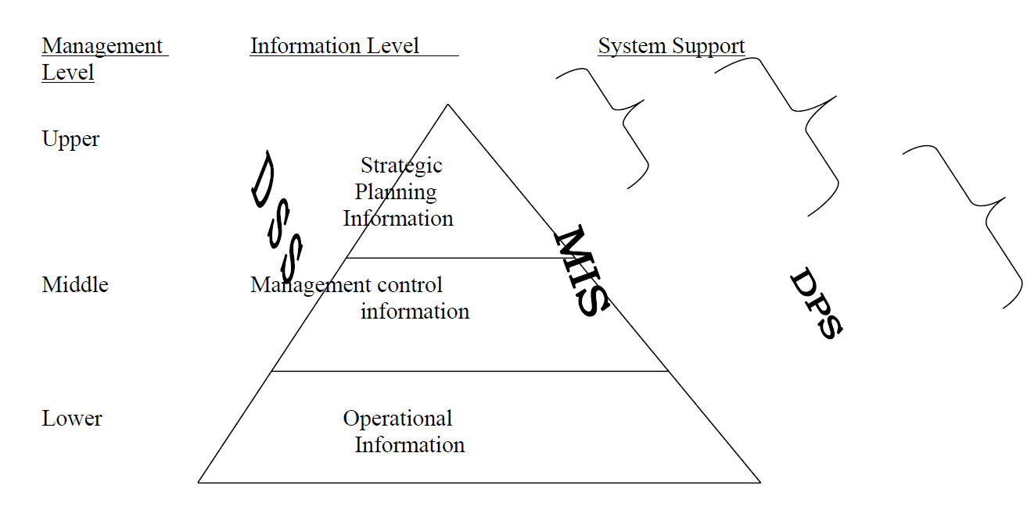

Slide 13
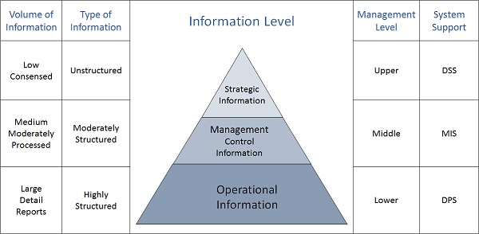

Slide 14
Succeeding as a Systems Analysts
To succeed as a systems analyst, you will need to develop four types of skills:
  analytical,
  technical,
  managerial, and
  interpersonal.
Notes:
A career as a systems analyst will allow you to have a significant impact on how your organization operates.
The primary role of a systems analyst is to study the problems and needs of an organization in order to determine how people, methods, and information technology can best be combined to bring about improvements in the organization. A systems analyst helps system users and other business managers define
their requirements for new or enhanced information services

Slide 15
Role of a Systems Analyst
Role of System Analyst
The system analyst is a person who is thoroughly aware of the system and guides the system development project by giving proper directions. He is an expert having technical and interpersonal skills to carry out development tasks required at each phase.
He pursues to match the objectives of information system with the organization goal.

Slide 16
Main Roles
Defining and understanding the requirement of user through various Fact finding techniques.
Prioritizing the requirements by obtaining user consensus.
Gathering the facts or information and acquires the opinions of users.
Maintains analysis and evaluation to arrive at appropriate system which is more user friendly.
Suggests many flexible alternative solutions, pick the best solution, and quantify cost and benefits.

Slide 17
Draw certain specifications which are easily understood by users and programmer in precise and detailed form.
Implement the logical design of system which must be modular.
Plan the period for evaluation after it has been used for some time, and modify the system as needed.

Slide 18
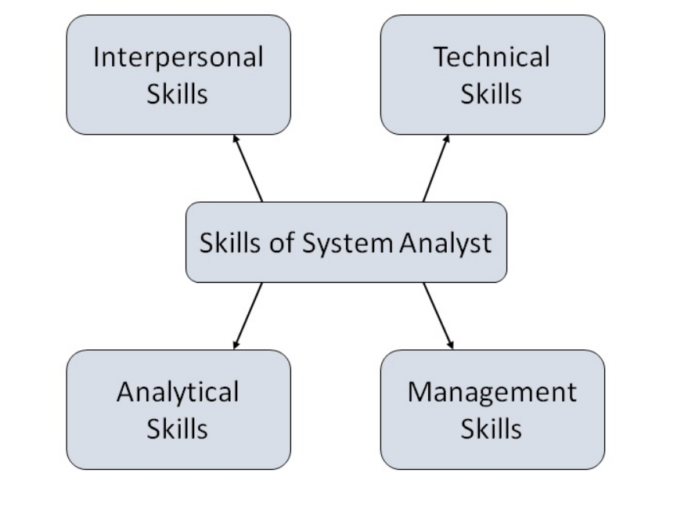
Attributes of a Systems Analyst
The following figure shows the attributes a systems analyst should possess −

Slide 19
Relationship between system analyst’s skills and SDLC phases
Interpersonal skills
    Project identification and selections phase
    Project initiation and planning phase
Analytical skills
    Analysis phase
Management skills
    Design phase
Technical skills
    Implementation phase
    Maintenance phase

Slide 20
Analytical skills for System analysts
We will focus on four sets of analytical skills. They are:
  System thinking
  Organizational knowledge
  Problem identification
  Problem analyzing and solving
Notes:
Analytical skills enable you to understand the organization and its functions, to identify opportunities and problems, and to analyze and solve problems. One of the most important analytical
skills you can develop is systems thinking, or the ability to see organizations and information systems as systems.

Slide 21
Analytical skills for System analysts:
1. System thinking
Systems and its characteristics
  System is an interrelated set of components, with identifiable boundary, working together for some purpose
A system has nine characteristics:
  Components----------------------Subsystems
  Interrelated components
  A boundary
  A purpose
  An environment
  Interfaces
  Input
  Output
  Constraints

Slide 22
Interface
Environment
Components
Input
Output
Boundary
Interrelationship

Slide 23
System characteristics
A component
    an irreducible part or aggregation of parts that make up a system, also called a subsystem
Interrelated components
    Dependence of one subsystem on one or more subsystems
Boundary
    The line that marks the inside and outside of a system and that sets off the system form its environment

Slide 24
System characteristics
Purpose
    The overall goal or function of a system
Environment
    Everything external to a system that interacts with the system
Interface
    Point of contact where a system meets its environment or where subsystems meet each other.

Slide 25
System characteristics
Constraint
    A limit to what a system can accomplish
Input
    Whatever a system takes from its environment in order to fulfill its purpose
Output
    Whatever a system returns from its environment in order to fulfill its purpose

Slide 26
A fast food restaurant as a system: Example
Environments: customers, food distribution, banks, etc.
Storage
Office
Outputs:
Prepared
food
Trash
Etc.
Inputs:
Food
,labor,
cash,
etc.
Kitchens
Dining
Room
Contour
Boundary
interrelationship

Slide 27
Open and Closed systems
Open system
    A system that interacts freely with its environment, taking input and returning output
Closed system
    A system that is cut off from its environment and does not interact with it

Slide 28
Logical and Physical system description
Logical system description
    Description of a system that focuses on the system function and purpose without regard to how the system will physically implemented
Physical system description
    Description of a system that focuses on the how the system will be materially constructed

Slide 29
Benefiting from systems thinking
    The first step in systems thinking is to be able to identify something as a system.
    Identify where the boundary lies and all of the relevant inputs
    Visualizing a set of things and their relationship as system allows you to translate a specify physical situation into more general.
    By decomposition
      The system into subsystems, we can analyze each subsystem separately and discover if one or more subsystem is at capacity.
      Its enabled us to determine its problem with demand

Slide 30
Organizational skills
Analyst should understand
  how organizations work
    Polices
    Terminologies, abbreviations, and acronyms
    Short/long term strategy and plans
    Role of technology
    The functions and procedures of the particular organization you are working for
  How the department operates,
    its purpose,
    its relationship with other department
    its relationship with customers and suppliers
  Who the experts are in different subject areas

Slide 31
Problem Identification skills
(Pound 1969) Problem is the difference between an existing (current) situation and desired (output) situation.
  The process of identifying problems is the process of defining differences, so problem solving is the process of finding a way to reduce differences.
  Analyst should able to compare the current in an organization to the desired situation.

Slide 32

Problem analyzing and solving Skills

Slide 33
Important system concepts
There are several other system concepts with which systems analysts need to become familiar:
    Decomposition
    Modularity
    Coupling
    Cohesion

Slide 34
Decomposition
Definition: The process of breaking down a system into smaller component
  The purpose of decomposition is to allow the system analysts to:
    Break a system into small, manageable subsystem
    Focus on one are at a time
  Concentrate one component pertinent to one group of users
  Build different components at independent times

Slide 35
Modularity and Coupling
Modularity
  Dividing a system up into chunks or modules of a relatively uniform size. To Simplify the redesign and rebuild process
Coupling
  The extend to which subsystems depend on each other.
  Subsystem should be independent as possible. If one subsystem fails and other subsystem are highly dependent on it, then the other will either fail themselves or have problems functioning

Slide 36
Cohesion
A cohesion is the extent to which a subsystem performs a single function.

Slide 37
Technical Skills (1)
Many aspects of your job as a system analyst are technically oriented.
The following activities will help you stay up-to-date:
  Read trade publications
  Join professional societies
  Attend classes or teach at a local college
  Attend many courses or training sessions offered by your organizations
  Attend professional conferences, seminars, or trade shows
  Participate in electronic bulletin, new groups

Slide 38
Technical Skills (2)
You should be familiar as possible with information technology:
  Microcomputer, micro station, workstation, mainframe computers
  Programming languages
  Operating systems
  Database and file management systems
  Data communication standards
  Software for local and wide networks
  Web developing tools
  Decision support system generators
  Data analysis tools
  Data design tools

Slide 39
Management Skills
System analysts are almost always members of project teams and are frequently asked to lead team.
Management skills are very useful for anyone in a leadership role.
There are four class of management skills:
  1- Resources
  2- Project
  3- Risk
  4- Change management

Slide 40
1- Resource management
Includes:
  Predicting resources usage (budgeting)
  Tracking and accounting for resources consumption
  Learning how to use resources effectively
  Securing resources from abusive use
  Evaluating the quality of resources used

Slide 41
Assignment
Describe your university or college as a system.
  What is the input?
  What is output?
  What is the boundary?
  What is the components and their relationship?
  The constraint
  The environment
Draw a diagram of this system

Slide 42
Interpersonal skills
Communication skills
Interviewing, Listening, and questionnaires
Written and oral presentations
  Meeting agenda
  Meeting minutes
  Interview summaries
  Requests for proposal from contractors and vendors
Working alone and with a team
Facilitating groups
Managing exceptions

